Slide 1
AI x Future

Slide 2
Agenda
Intro to Effective Altruism
Intro to Systems Map
Intro to AI x Future
Assumptions & Knowledge
Subtopics discussions
Pro and cons
Regroup after table discussion
Summary
Actionables
Drinks

Slide 3
Intro to Effective Altruism
Example: Drowning in a pond
Notes:
Best suit/dress, on your way to a wedding
Save the child? Duh.
Global empathy.

Slide 4
Intro to Effective Altruism
“Using reason and evidence to do the most good”
Neglected Scalable Tractable
Notes:
Neglected
Scalable/Solvable
Tractable

Slide 5
Intro to Effective Altruism
“Using reason and evidence to do the most good”
Open-minded Critical Thinking Global Empathy
Notes:
Open-mined
Critical Thinking
Global Empathy

Slide 6
Intro to Effective Altruism
Poverty/Health AI Safety Bio Security
Factory Farming EA work Charity Entrepreneurship
Notes:
EA is a movement.
Many areas.

Slide 7
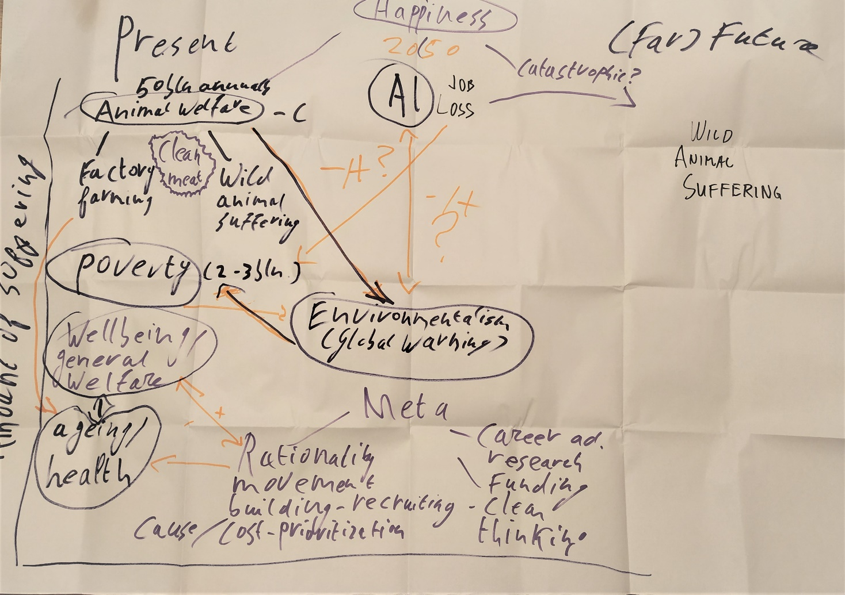
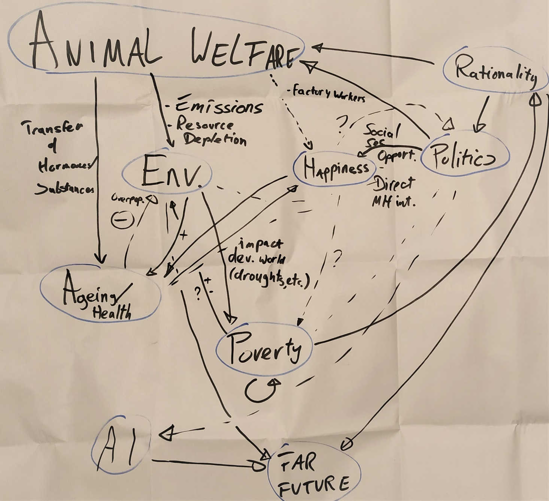
Intro to Systems Map
“Systems maps have a very simple form, consisting of blobs and words, and they're used to show the structure of a system of interest at a point in time”
Notes:
Here was our start, today we will deepen our knowledge on a specific topic

Slide 8
Goal of the evening
Provide knowledge and a new way of seeing the problem (through an EA lens);
To better know what actions to take yourself to have a positive impact

Slide 9
What do you think?
What do you already know about Artificial Intelligence?
How do you think it will impact our near and far future?
What do you want to learn/test this evening?
Notes:
WRITE THIS DOWN

Slide 10
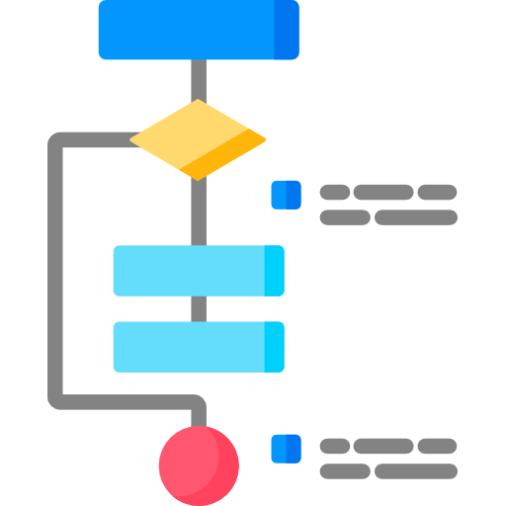
Intro to AI x Future
Artificial Intelligence (AI)
The capability of machines to perform intellectual tasks, such as recognizing objects, forming plans to achieve goals and making predictions
Artificial Narrow Intelligence (ANI)
AI being very good at a specific task – like Chess/Go/Image Recognition
Artificial General Intelligence (AGI)
A machine that can perform any intellectual task that a human being can (ish…)
Artificial Superintelligence (ASI)
An intellect that is much smarter than the best human brains in practically every field, including scientific creativity, general wisdom and social skills
Notes:
https://concepts.effectivealtruism.org/concepts/artificial-intelligence/
hard = easy and other way around
AI Caliber 1) Artificial Narrow Intelligence (ANI): Sometimes referred to as Weak AI, Artificial Narrow Intelligence is AI that specializes in one area. There’s AI that can beat the world chess champion in chess, but that’s the only thing it does. Ask it to figure out a better way to store data on a hard drive, and it’ll look at you blankly.
AI Caliber 2) Artificial General Intelligence (AGI): Sometimes referred to as Strong AI, or Human-Level AI, Artificial General Intelligence refers to a computer that is as smart as a human across the board—a machine that can perform any intellectual task that a human being can. Creating AGI is a much harder task than creating ANI, and we’re yet to do it. Professor Linda Gottfredson describes intelligence as “a very general mental capability that, among other things, involves the ability to reason, plan, solve problems, think abstractly, comprehend complex ideas, learn quickly, and learn from experience.” AGI would be able to do all of those things as easily as you can.
AI Caliber 3) Artificial Superintelligence (ASI): Oxford philosopher and leading AI thinker Nick Bostrom defines superintelligence as “an intellect that is much smarter than the best human brains in practically every field, including scientific creativity, general wisdom and social skills.” Artificial Superintelligence ranges from a computer that’s just a little smarter than a human to one that’s trillions of times smarter—across the board. ASI is the reason the topic of AI is such a spicy meatball and why the words “immortality” and “extinction” will both appear in these posts multiple times.
As of now, humans have conquered the lowest caliber of AI—ANI—in many ways, and it’s everywhere. The AI Revolution is the road from ANI, through AGI, to ASI—a road we may or may not survive but that, either way, will change everything.

Slide 11
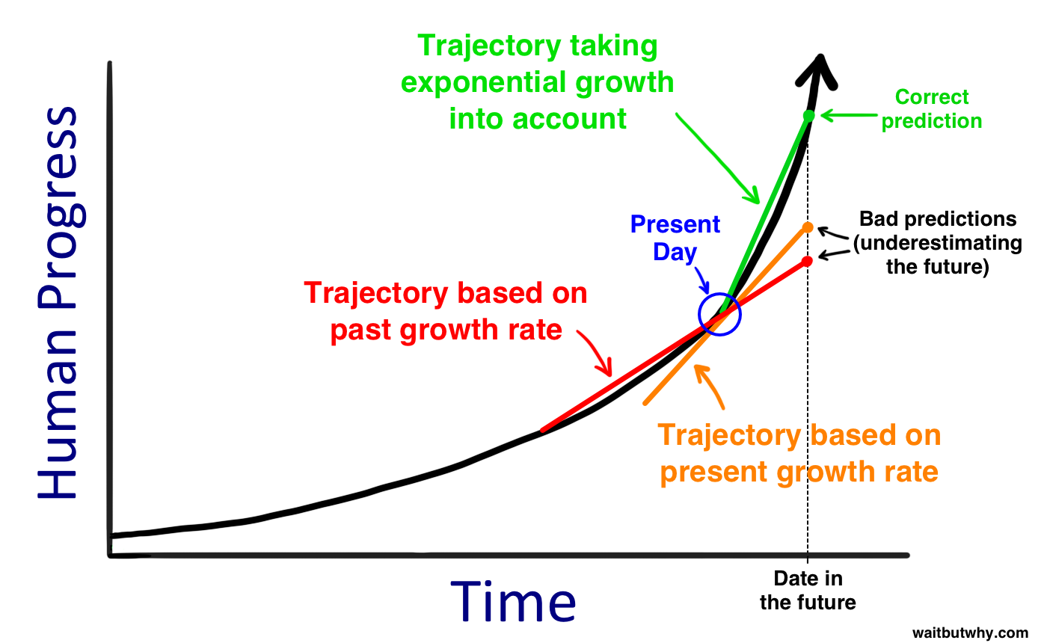
Intro to AI x Future
Linear vs Exponential Growth
The king, the peasant and the chessboard story
Notes:
A classic story about this effect is called "The wheat and the chessboard" (or "The rice and the chessboard"). It is accom­panied by a story about a king whose life is saved by a poor farmer.
In gratitude, the king says he will grant the farmer a wish. The farmer asks for a quantity of wheat or rice, the amount to be determined by using a chessboard, which has 64 squares.
A single grain will be placed on the first square, then the amount will be doubled for each square after that: 2 grains, then 4, then 8, and so on to the end of the board. If the king is foolish enough to agree, he will owe the peasant 18,446,744,073,709,551,615 grains by the 64th square. The king's storehouses are empty long before then.
https://www.psywww.com/gst/linear-vs-exponential-growth.html
S-curve possibility.

Slide 12
Intro to AI x Future
Where are we now?
Cashier-less check-out Self-driving Trucks Energy grid management
Notes:
ANI everywhere
Cashier-less check-out – Amazon Go – even more in China
Self-driving trucks – Otto, Volvo,
Energy grid management – Google/Alpabet, drastic decrease in energy use
More examples: Siri, Spotify playlists, Netflix algorithm, Recommended for you on Amazon/bol.com, trading algorithms, image scanners, phones (cameras)

Slide 13
Intro to AI x Future
How smart is today's artificial intelligence?
https://youtu.be/IJKjMIU55pE?t=29

Slide 14
Intro to AI x Future
We can go from ANI to ASI because we now have…
Hardware Software Data
Notes:
AI expert Jan here?
Hardware – speed, size and storage, reliability and durability
Software – learn like the brain, recursive learning (don’t even need hardware)
Data – exponential growth

Slide 15
Intro to AI x Future
What can go right? And wrong?
Right
Goal alignment
Food, energy, resource abundance
More happiness for more people
Wrong
Goal-hacking
Inequality dialled to 11
Unconscious super-brain
Notes:
Goal-alignment – AI has same goals as us
Goal-hacking – finds a ‘cheat’ in game (happened), or makes ‘cancer cure’ with some effects, others dead because goal was no people dying from cancer

Slide 16
AI x Future
Discussion of specific-subtopics
Split up in two groups of the same size
Pro tip: If you’re here with a friend, both join different groups

Slide 17
AI x Future
Conclusions

Slide 18
Conclusion
Lessons Learnt

Slide 19
EA Outro
Effective Altruism:
https://www.effectivealtruism.org/
80000hours, career advice:
https://80000hours.org
Effective Altruism Rotterdam:
https://earotterdam.nl/

